Slide 1
COMPUTER GRAPHICS AND VISUALIZATION PROJECT
THE SNAKE GAME
BY
Mehul B. Bhatt Anupam Kumar
USN:- 1RI12CS401 USN:- 1RI12CS005
Under The Guidance of
Mrs. Poornima U.S
Assistant Professor
Dept. of CSE,
R.R.I.T., Bangalore
Mrs. Rashmi
Assistant Professor
Dept. of CSE,
R.R.I.T., Bangalore

Slide 2
ABSTRACT
The project entitled “Snake Game” demonstrates the animation game used in OpenGL.
It will include computer controlled intelligent opponents whose aim will be to challenge the human players.
The simplicity of this game makes it an ideal candidate for a minor project as we can focus on advanced topics like implementation of computer controlled intelligent opponents.

Slide 3
Introduction to OpenGL
OpenGL is a low-level graphics library specification. It makes available to the programmer a small set of geometric primitives – points, lines, polygons, image and bitmaps.
Since OpenGL drawing commands are limited to those that generate simple geometric primitives (points, lines and polygons), the OpenGL Utility Toolkit (GLUT) has been created to aid in the development of more complicated three-dimension object such as a sphere, a cube, a cone etc.
GLUT is designed to fill to need for windows system independent programming interface for OpenGL programs. The interface is designed to be simple yet still meet the needs of useful OpenGL programs.

Slide 4
The GLUT Application Programming Interface (API) requires very few routines to display a graphic scene render using OpenGL. The GLUT routines also take relatively few parameters.
Rendering Pipeline:-
Most implementation of OpenGL has a similar order of operations, a series of processing stages called the OpenGL rendering pipeline.
Rasterization:-
Rasterization is the conversion of both geometric and pixel data into fragments. Each fragment square corresponds to a pixel in the frame buffer.
The processed fragment is the drawn into the appropriate buffer, where it has finally advanced to be a pixel and achieved its final resting place.
Libraries:-
OpenGL provides a powerful but primitives set of rendering commands and all higher-level drawing must be done in terms of these commands.
OpenGL Utility Library (GLU) contains several routines that use lower-level OpenGL commands.
OpenGL Utility Toolkit (GLUT) is a windows system independent toolkit, written by MARK KILGARD, to hide complexities of differing windows APIs.

Slide 5
Introduction of Project
A game is structured playing, usually undertaken for enjoyment and sometimes used as an educational tool. Games are distinct from work, which is usually carried out for remuneration, and from art, which is more often an expression of aesthetic or ideological elements.
Normally screen color of graphical window is white, for change it we are using Light Functionality by given by OpenGL.
Light function is use to change the color of back gourd. In this function there are 3 type of light.
Ambient Light:-
Ambient lighting is a general illumination that comes from all direction in a room that has no visible source. This type of lighting is in contrast to directional lighting.
Positioned Light:-
Positioned light is declared for the contrast. Contrast is also important and poorly positioned light source may cause contrast reduction, resulting in loss of visibility.
Directed Light:-
Directional lights are different from the previous two by the fact that all the light rays are parallel to each other.

Slide 6
Now make part of the project is Snake and its Food. The shape of Snake is making with help of Solid Sphere and Cone and colored with the Color function. The Snake’s Food also make by the Solid Sphere and Color function.
When Snake start eating the Food it will also increase in size and after eating each Food point also get increase.
The snake runs within the cube itself, if it reaches any of the side it will reappear from opposite side.
The cube can be rotate in X-axis, Y-axis and Z-axis and even it can be zoom-in and zoom-out.
In we are tracking each and every position of snake within the cube.
The FPS means Frame per Second, FPS means to increase Frames per Seconds you can lower the Graphics the FPS will increase. The human eye can see about 30 FPS, but for things like game 60+ is ideal.

Slide 7
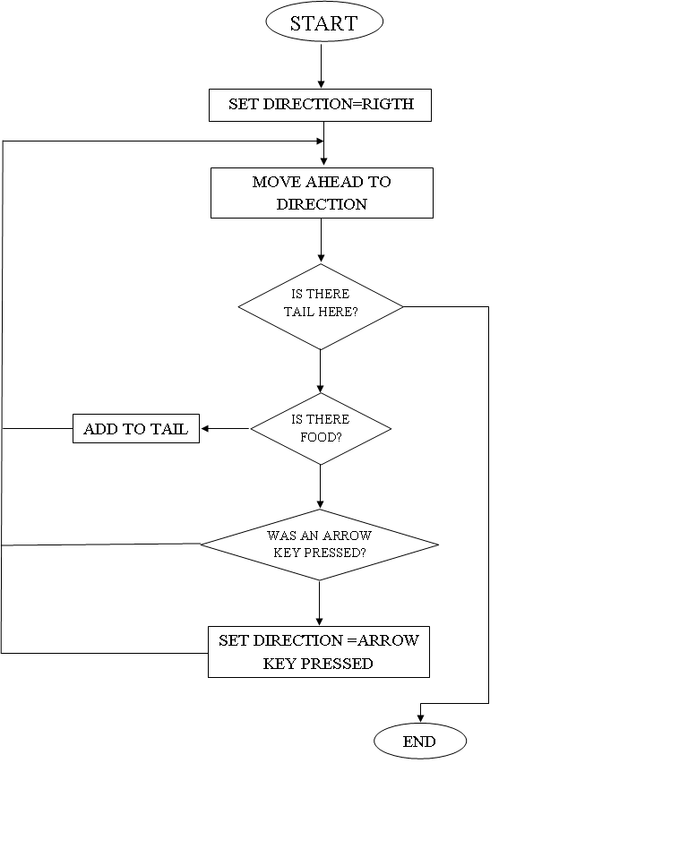
Flow Chart

Slide 8
Design
Project design first requires gathering, synthesizing, and analyzing information with enough objectivity and detail to support a program decision that makes optimum use of resources to achieve desired results.
Text:-
Text feature in OpenGL is very use to show character, number or any special symbols in the graphical window. In this project the text feature is to display Welcome Screen, Position of Snake, Level, Points, Fps value.
GlutBitmapCharacter():-Without using any display lists, glutBitmapCharacter renders the character in the named bitmap font. The available fonts are:
GLUT_BITMAP_8_BY_13
A fixed width font with every character fitting in an 8 by 13 pixel rectangle.

Slide 9
GlRasterPos():-
The raster position is transformed by the modelview matrix. If you are applying some matrix to your modelview while panning and zooming, then it will affect glRasterPos2f. You might want to load an identity matrix, then call glRasterPos2f.
Snake and Food:-
GlutSolidsphere ():-
Renders a sphere centered at the modeling coordinates origin of the specified radius. The sphere is subdivided around the Z axis into slices and along the Z axis into stacks.
GLRotatef():-
GLRotate produces a rotation of angle degrees around the vector (x, y, z). The current matrix (see GLMatrixMode) is multiplied by a rotation matrix with the product replacing the current matrix.
GLTranslatef():-
GLTranslate produces a translation by (x, y, z). The current matrix (see GLMatrixMode) is multiplied by this translation matrix, with the product replacing the current matrix.

Slide 10
Surface and Viewing Angels:-
The Surface or Plane is main module of this project. The Snake will run within this surface only.
GlutSolidCube():-
GlutSolidCube and GlutWireCube render a solid or wireframe cube respectively. The cube is centered at the modeling coordinate’s origin with sides of length size.
GlutPostRedispaly ():-
Mark the normal plane of current window as needing to be redisplayed. The next iteration through glutMainLoop, the window's display callback will be called to redisplay the window's normal plane.

Slide 11
Future Enhancement
To get good knowledge about OpenGL for gaming, this project will help in future to get the logic for design and implementation for game.
By modifying this project in future we can make good graphic and make more interactive with user and other devices.
Game making is to develop such kind of software that use only for only entertainment purpose.
The game you can use in mobile or computer and its very user friendly for both devices.
Games are developed as a creative outlet and to generate profit. Development is normally funded by a publisher.

Slide 12
Conclusion
This project “Snake Game” was designed and implemented by solely by its creators as the exercise of “Computer Graphics and Visualization” Laboratory.
The concept used in the design are that our own, but certain referrals were made to my lectures and others regarding some technical issues. More features to make it a competitive.
Further work on project like this would enable greater knowledge an prowess in OpenGL.
This project is only for entertainment for children and it can be implement on Mobile devise also for entertainment.

Slide 13
THANK YOU

